Slide 1
CS1231 Tutorial 7
AY18/19 – WEEK 9
Andrew Tan

Slide 2
Functions
Functions are relations such that each “input” to the function must have only one output.

Slide 3
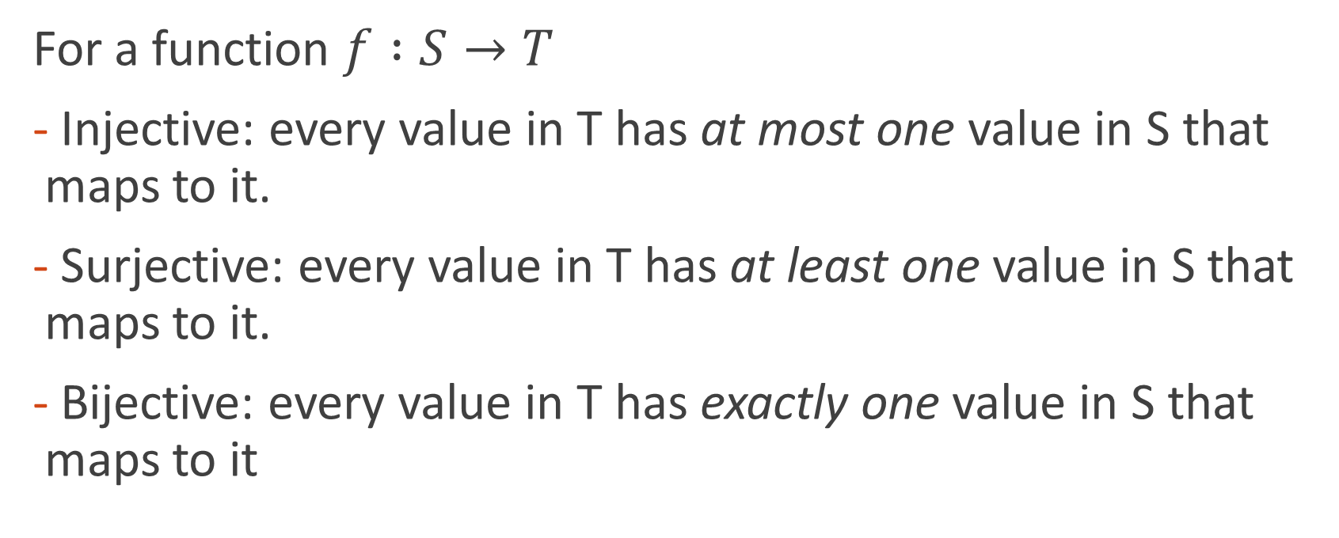
Function properties
For a function $f :S→T$
Injective: every value in T has at most one value in S that maps to it.
Surjective: every value in T has at least one value in S that maps to it.
Bijective: every value in T has exactly one value in S that maps to it

Slide 4
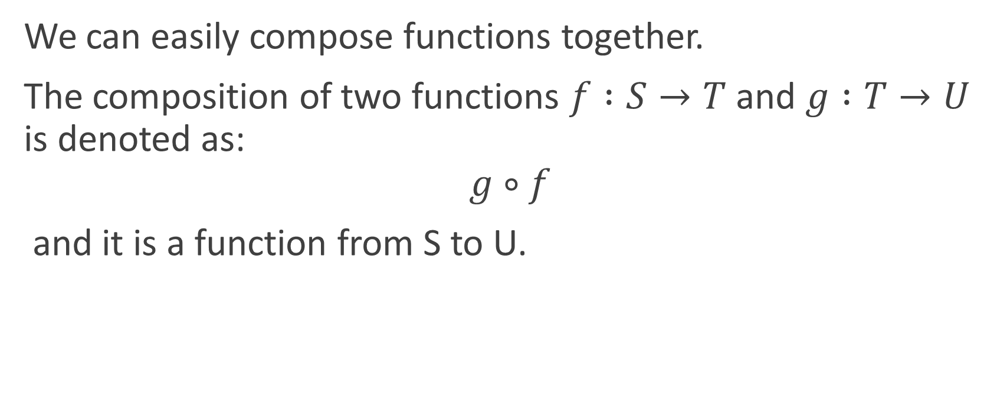
Composition
We can easily compose functions together.
The composition of two functions $f :S→T$ and $g :T→U$ is denoted as:
$$g∘f$$
and it is a function from S to U.

